Slide 1


Unsupervised Learning
Clustering
Abonia Sojasingarayar
Diakariaou (Zakaria ) Goundiam
M2,B3-Artificial Intelligence-IA school
June,2020

Slide 2
Outline
Introduction to clustering
Clustering Techniques
K-means
Hierarchical clustering
Application of clustering
Summary

Slide 3
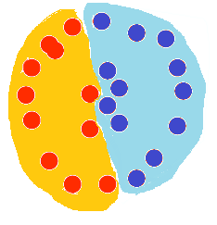
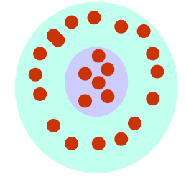
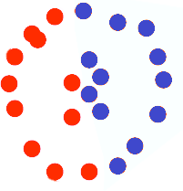
What is clustering?
The organization of unlabeled data into similarity groups called clusters.
A cluster is a collection of data items which are “similar” between them, and “dissimilar” to data items in other clusters.

Slide 4
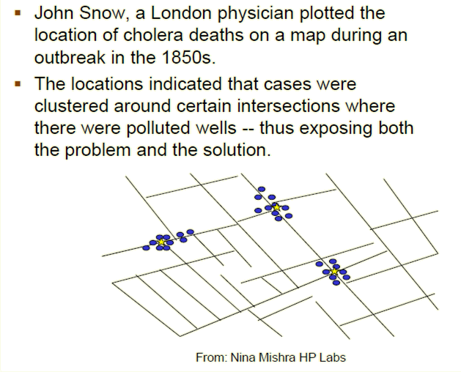
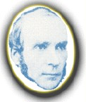
Historic application of clustering

Slide 5
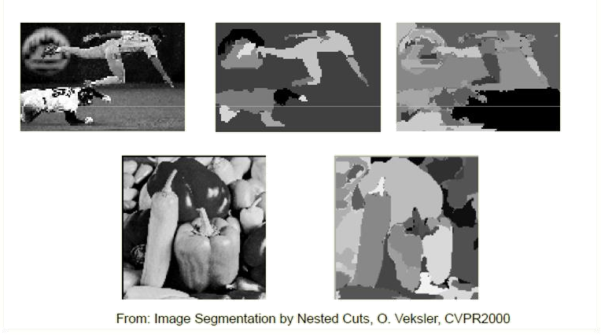
Computer vision application:
Image segmentation

Slide 6
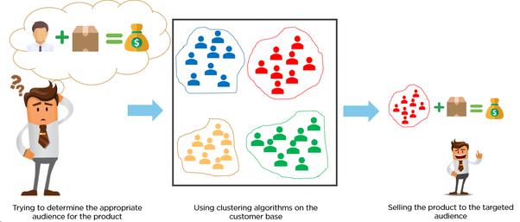
How clustering solve business problem Example:Customer Segmentation
Image Source:https://medium.com/analytics-vidhya/customer-segmentation-for-differentiated-targeting-in-marketing-using-clustering-analysis-3ed0b883c18b

Slide 7
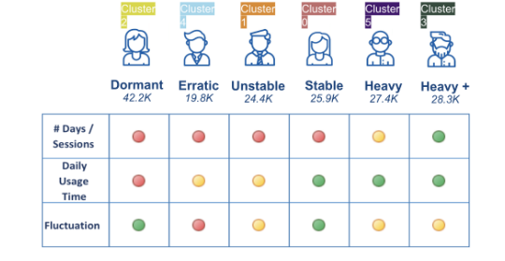
Clustering Real World Example:
Customer segmentation
Image Source:https://medium.com/@sygong/k-means-clustering-for-customer-segmentations-a-practical-real-world-example-196a10323b9f

Slide 8
Types of clustering
Hard Clustering: In hard clustering, each data point either belongs to a cluster completely or not.
For example, in the previous example each customer is put into one group out of the 6 groups.
Soft Clustering: In soft clustering, instead of putting each data point into a separate cluster, a probability or likelihood of that data point to be in those clusters is assigned.
For example, from the above scenario each costumer is assigned a probability to be in either of 6 clusters of the retail store.

Slide 9
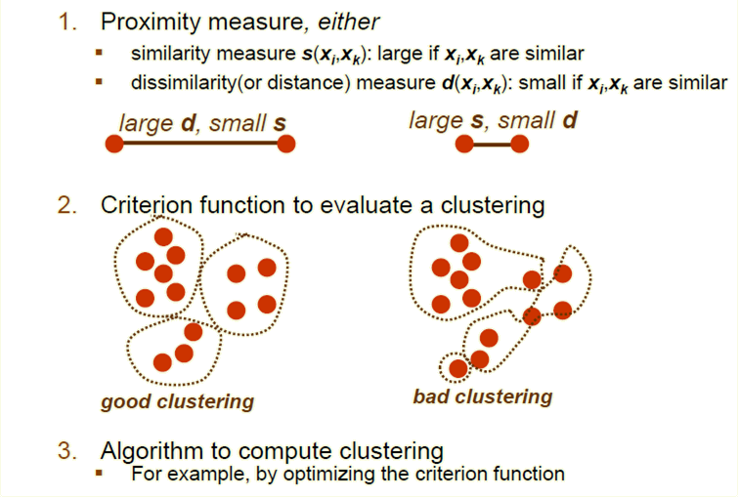
What do we need for clustering?

Slide 10
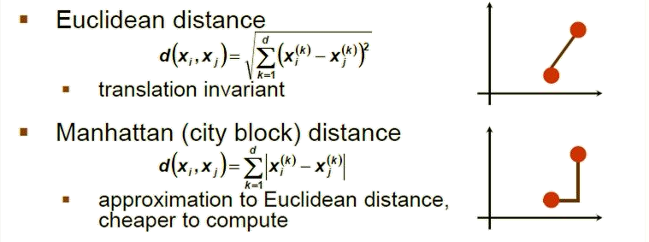
Distance (dissimilarity) measures
They are special cases of Minkowski distance:
1
⎛
p _{⎞⎟ p}
d _{p} (x_{i} , x _{j} ) =
⎜
∑
m
x − x
⎝
k =1
ik
jk
⎠
(p is a positive integer)

Slide 11
Cluster evaluation (a hard problem)
Intra-cluster cohesion (compactness):
Cohesion measures how near the data points in a cluster are to the cluster centroid.
Sum of squared error (SSE) is a commonly used measure.
Inter-cluster separation (isolation):
Separation means that different cluster centroids should be far away from one another.
In most applications, expert judgments are still the key

Slide 12
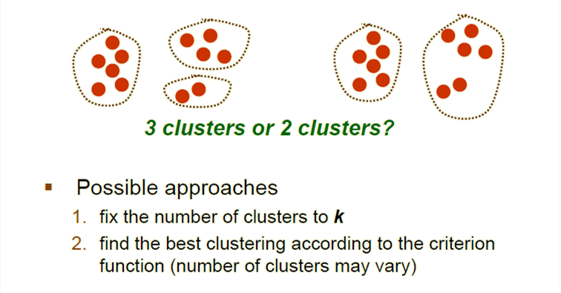
How many clusters?

Slide 13
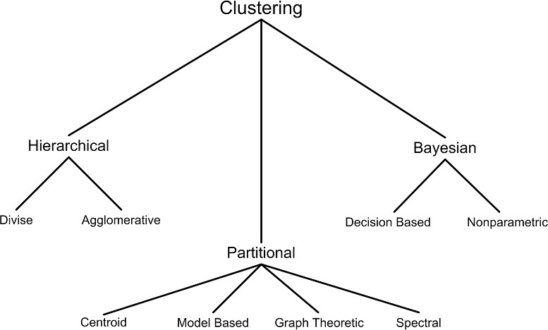
Clustering techniques
Divisive

Slide 14
Clustering Techniques
Hierarchical algorithms find successive clusters using previously established clusters.These algorithms can be either agglomerative(‘Bottom-up’) or divisive(‘top-down’):
Agglomerative Algorithm begin with each element as a seperate cluster and merge them into successively large clusters.
Divisive algorithm begin with the whole set and proceed to divide it into successively smaler clusters.
Partitional algorithms typically determine all clusters at once,but can also be used as divisive algorithms in hierarchical clustering
Bayesian algorithms try to generate a posteriori distribution over the collection of all partition of data.

Slide 15
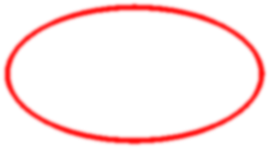
Clustering techniques
K-means

Slide 16
K-means Clustering
K-means (MacQueen, 1967) is a partitional clustering algorithm
Let the set of data points D be {x₁, x₂, …, x_{n}},
where x_{i} = (x_{i1}, x_{i2}, …, x_{ir}) is a vector in X ⊆ R^{r}, and r is the number of dimensions.
The k-means algorithm partitions the given data into k clusters:
Each cluster has a cluster center, called centroid.
k is specified by the user

Slide 17
K-means algorithm
Given k, the k-means algorithm works as follows:
Choose k (random) data points (seeds) to be the initial centroids, cluster centers
Assign each data point to the closest centroid
Re-compute the centroids using the current cluster memberships
If a convergence criterion is not met, repeat steps 2 and 3

Slide 18
K-means convergence (stopping) criterion
no (or minimum) re-assignments of data points to different clusters, or
no (or minimum) change of centroids, or
minimum decrease in the sum of squared error (SSE),
k
SSE = ∑∑
d (x, m )²
x∈C _{j}
j
j =1
C_{j} is the jth cluster,
m_{j} is the centroid of cluster C_{j} (the mean vector of all the data points in C_{j}),
d(x, m_{j}) is the (Eucledian) distance between data point x and centroid m_{j}.

Slide 19
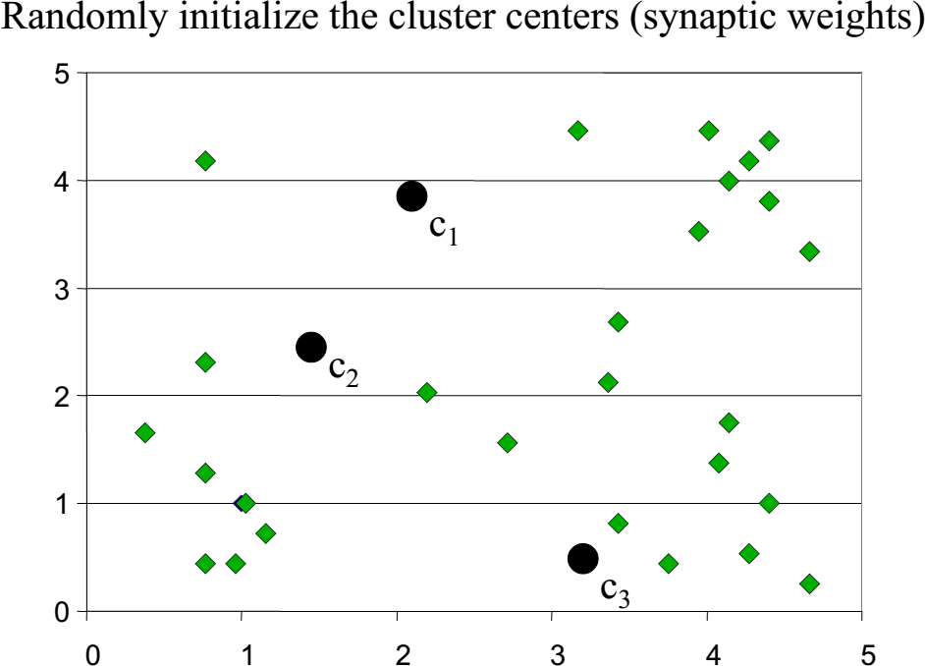
K-means clustering example: step 1

Slide 20

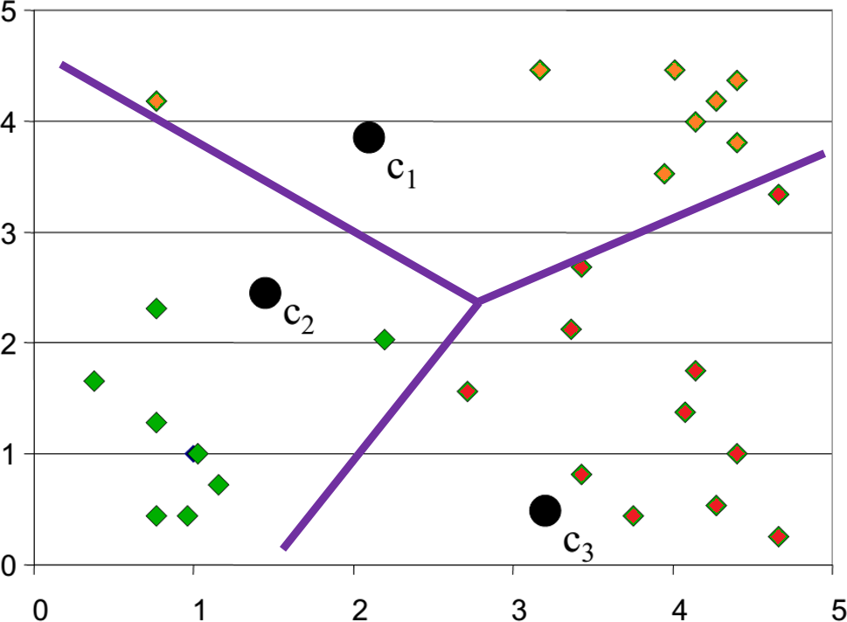
K-means clustering example: step 2

Slide 21
K-means clustering example: step 3

Slide 22
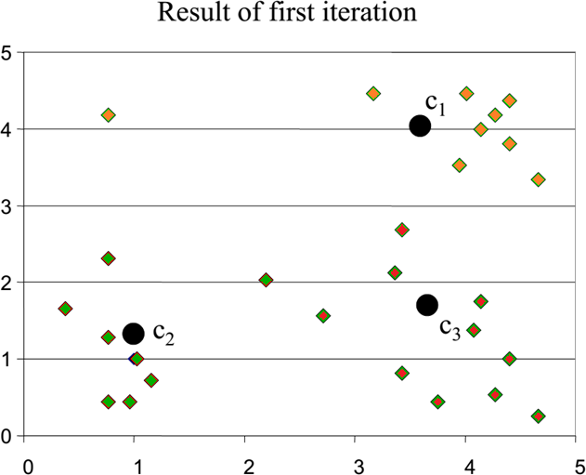
K-means clustering example

Slide 23
K-means clustering example

Slide 24
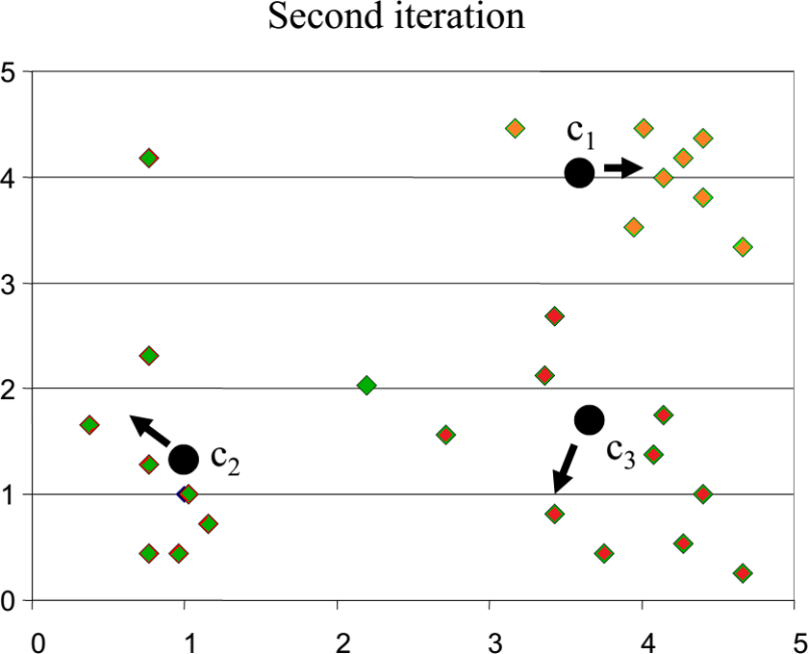
K-means clustering example

Slide 25
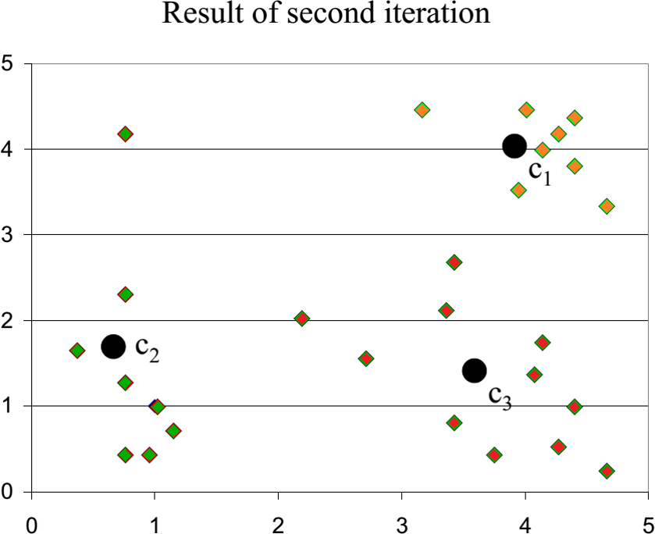
K-means clustering example

Slide 26
Why use K-means?
Strengths:
Simple: easy to understand and to implement
Efficient: Time complexity: O(tkn), where n is the number of data points, k is the number of clusters, and
t is the number of iterations.
Since both k and t are small. k-means is considered a linear
algorithm.
K-means is the most popular clustering algorithm.
Note that: it terminates at a local optimum if SSE is used. The global optimum is hard to find due to complexity.

Slide 27
Weaknesses of K-means
The algorithm is only applicable if the mean is defined.
For categorical data, k-mode - the centroid is represented by most frequent values.
The user needs to specify k.
The algorithm is sensitive to outliers
Outliers are data points that are very far away from other data points.
Outliers could be errors in the data recording or some special data points with very different values.

Slide 28
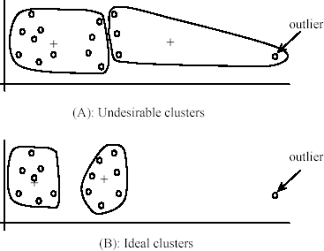
Outliers

Slide 29
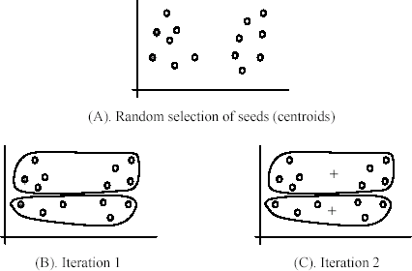
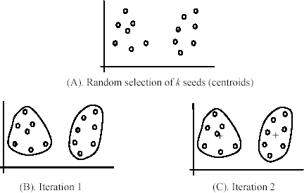










Sensitivity to initial seeds
Random selection of seeds (centroids)
Random selection of seeds (centroids)
Iteration 1
Iteration 2
Iteration 1
Iteration 2

Slide 30
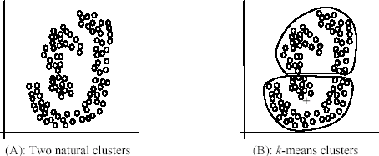

Special data structures
The k-means algorithm is not suitable for discovering clusters that are not hyper-ellipsoids (or hyper-spheres).

Slide 31
K-means summary
Despite weaknesses, k-means is still the most popular algorithm due to its simplicity and efficiency
No clear evidence that any other clustering algorithm performs better in general
Comparing different clustering algorithms is a difficult task. No one knows the correct clusters!

Slide 32
Types of hierarchical clustering
Divisive (top down) clustering
Starts with all data points in one cluster, the root, then
Splits the root into a set of child clusters. Each child cluster is
recursively divided further
stops when only singleton clusters of individual data points remain, i.e., each cluster with only a single point
Agglomerative (bottom up) clustering
The dendrogram is built from the bottom level by
merging the most similar (or nearest) pair of clusters
stopping when all the data points are merged into a single cluster (i.e., the root cluster).

Slide 33
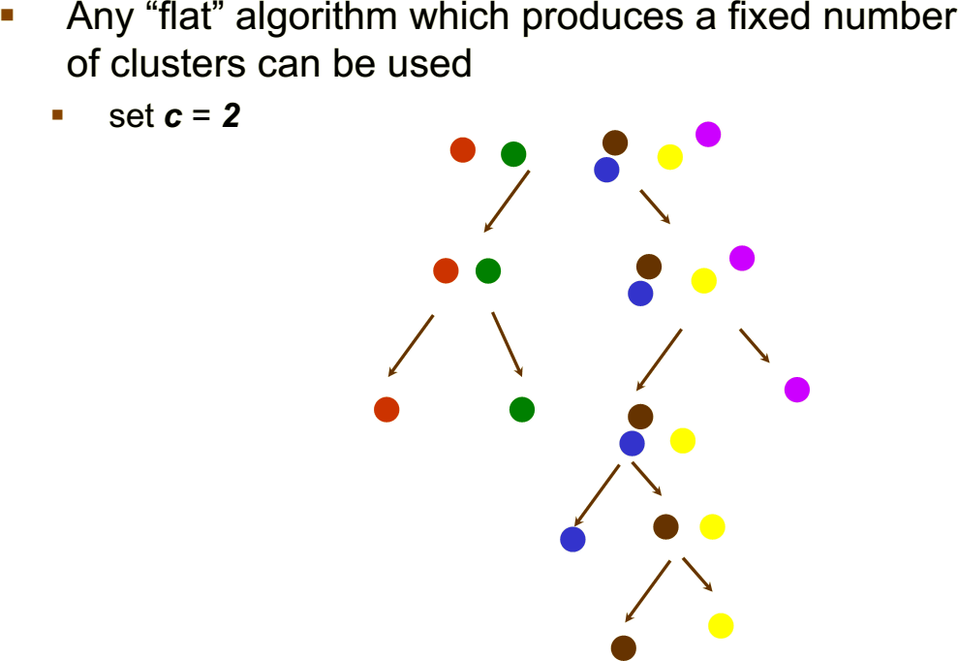
Divisive hierarchical clustering

Slide 34
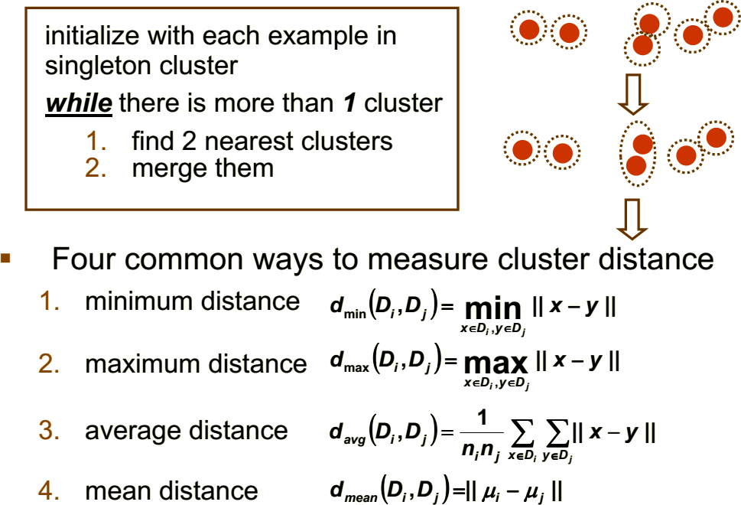
Agglomerative hierarchical clustering

Slide 35
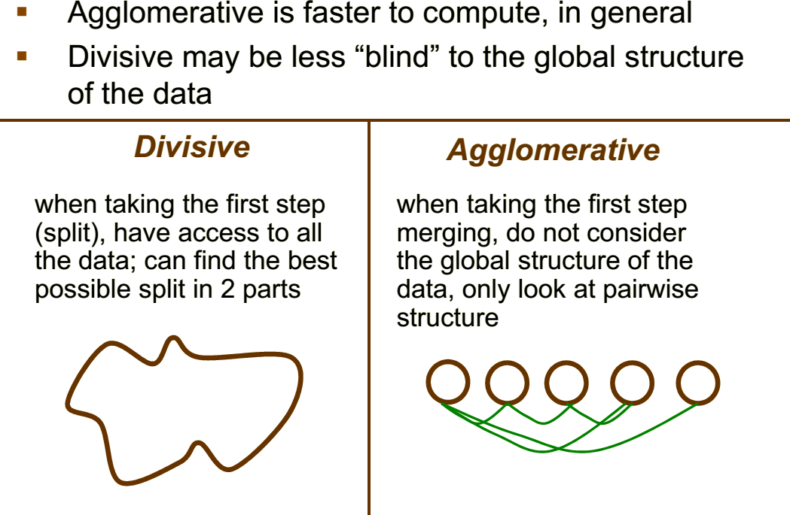
Divisive vs. Agglomerative

Slide 36
K-Means vs Hierarchical Clustering
Hierarchical clustering can’t handle big data well but K Means clustering can. This is because the time complexity of K Means is linear i.e. O(n) while that of hierarchical clustering is quadratic i.e. O(n²).
In K Means clustering, since we start with random choice of clusters, the results produced by running the algorithm multiple times might differ. While results are reproducible in Hierarchical clustering.
K Means is found to work well when the shape of the clusters is hyper spherical (like circle in 2D, sphere in 3D).
K Means clustering requires prior knowledge of K i.e. no. of clusters you want to divide your data into. But, you can stop at whatever number of clusters you find appropriate in hierarchical clustering by interpreting the dendrogram

Slide 37
Application Area
Recommendation engines
Market segmentation
Social network analysis
Search result grouping
Medical imaging
Image segmentation
Anomaly detection

Slide 38
Summary
Clustering has a long history and still is in active research
There are a huge number of clustering algorithms, among them: Density based algorithm, Sub-space clustering, Scale-up methods, Neural networks based methods, Fuzzy clustering, Co-clustering …
More are still coming every year
Clustering is hard to evaluate, but very useful in practice
Clustering is highly application dependent (and to some extent subjective)
Competitive learning in neuronal networks performs clustering analysis of the input data

Slide 39
References
[1]SauravKaushik,Available:https://www.analyticsvidhya.com/blog/2016/11/an-introduction-to-clustering-and-different-methods-of-clustering/
[2] Shimon Ullman + Tomaso Poggio Danny Harari + Daneil Zysman + Darren Seibert, Clustering,Fall semesterPublishing, 2014.
[3] Jason Brownlee PhD Available:https://machinelearningmastery.com/clustering-algorithms-with-python/

